Slide 1
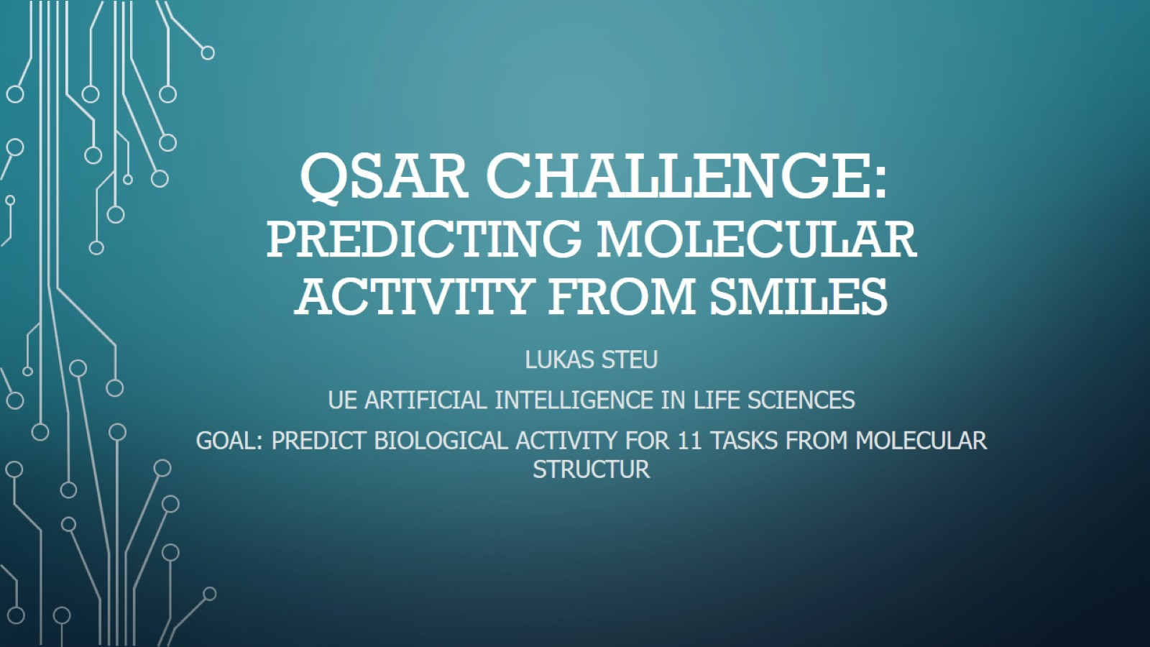
QSAR Challenge: Predicting Molecular activity from Smiles

Slide 2
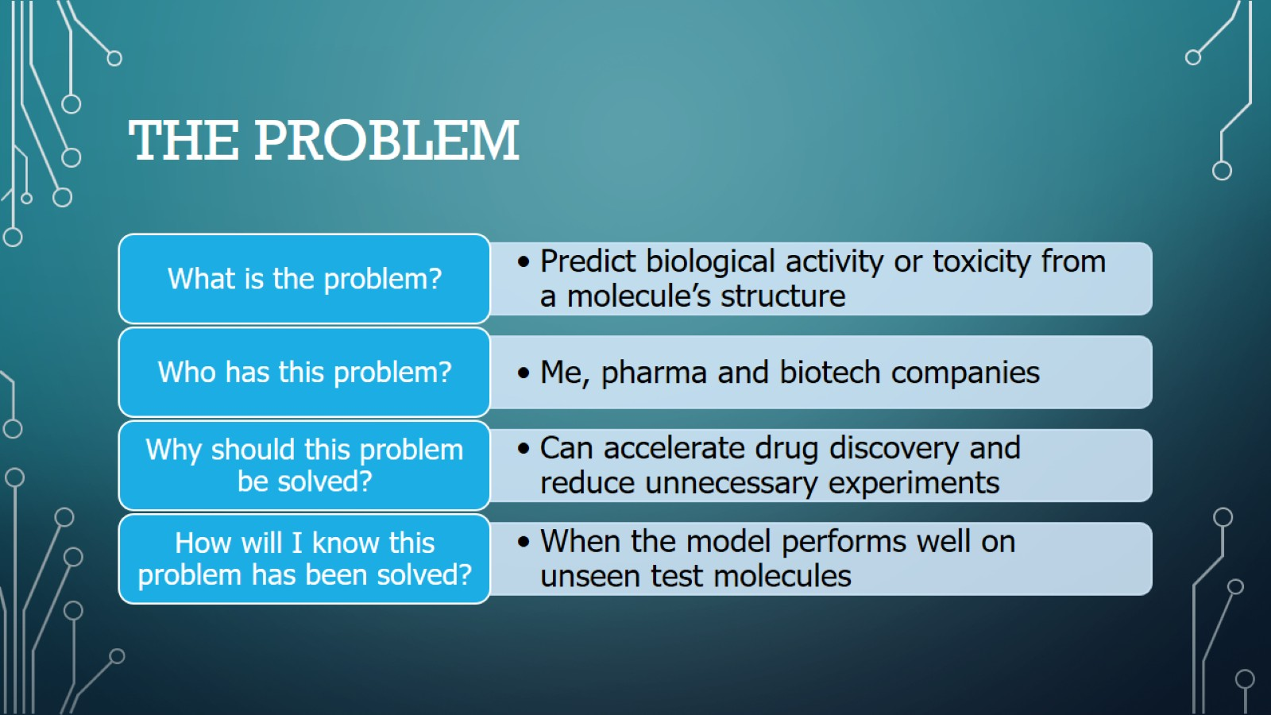
The Problem

Slide 3
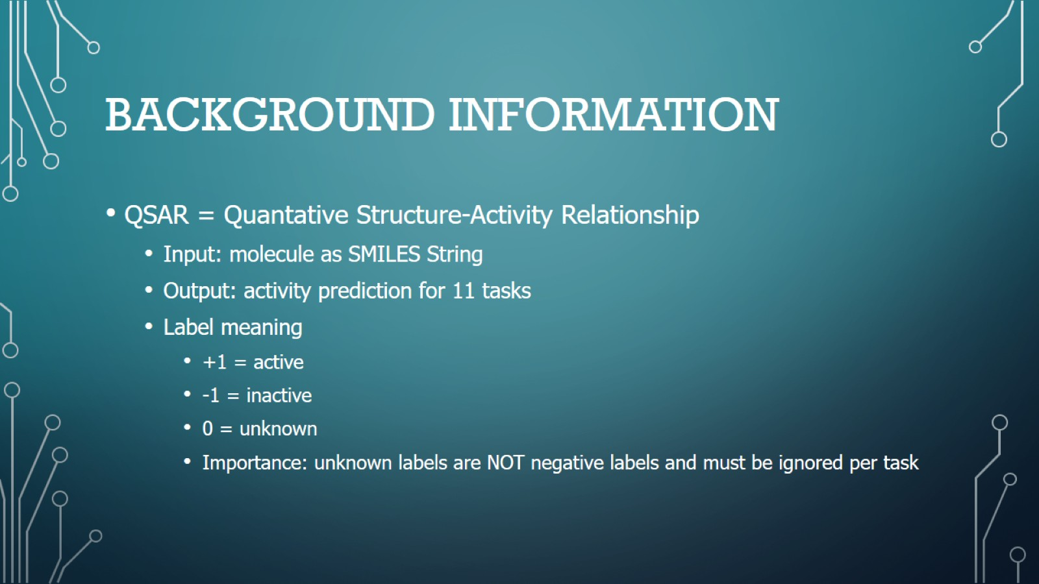
Background Information

Slide 4
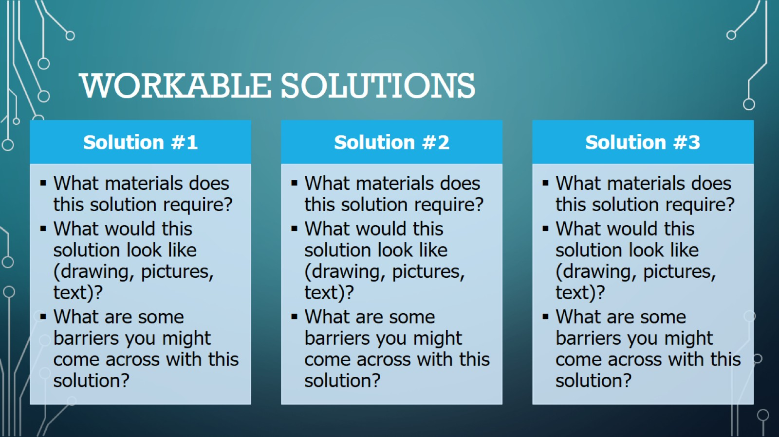
Workable Solutions

Slide 5
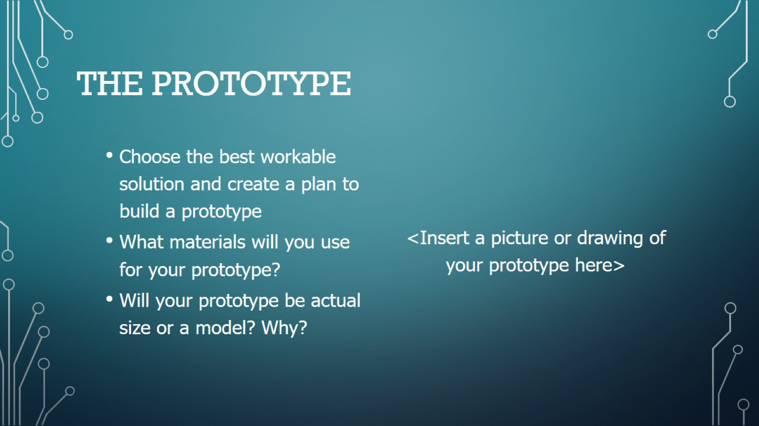
The Prototype

Slide 6
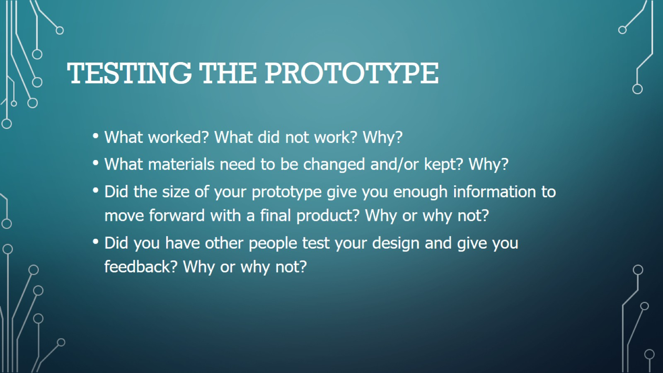
Testing The Prototype

Slide 7
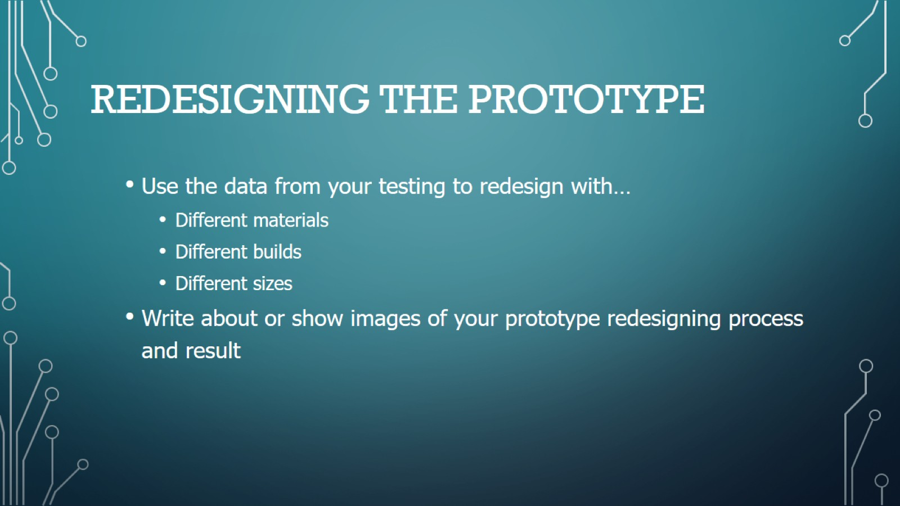
Redesigning The Prototype

Slide 8
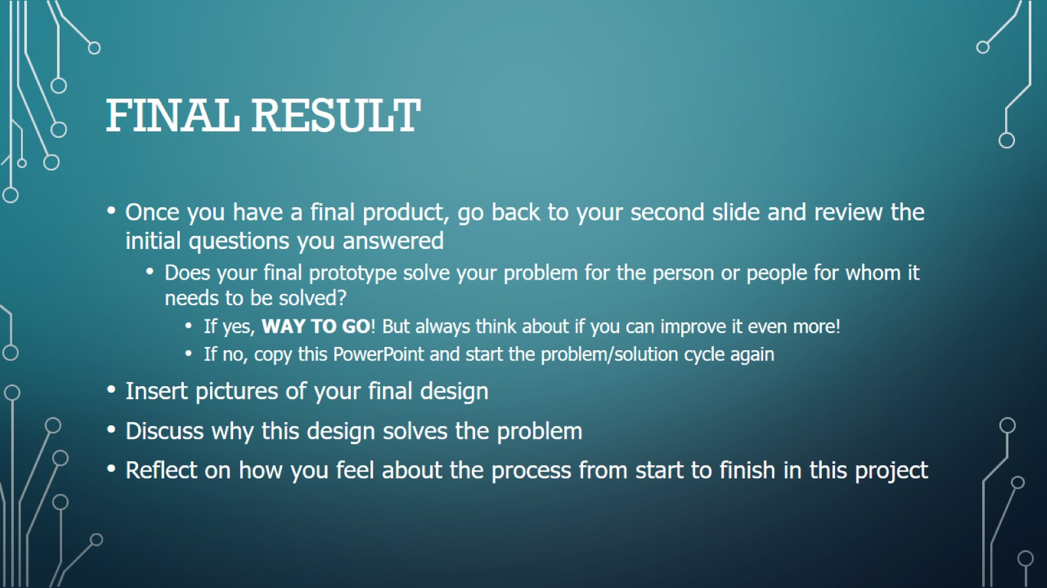
Final Result

